Slide 1
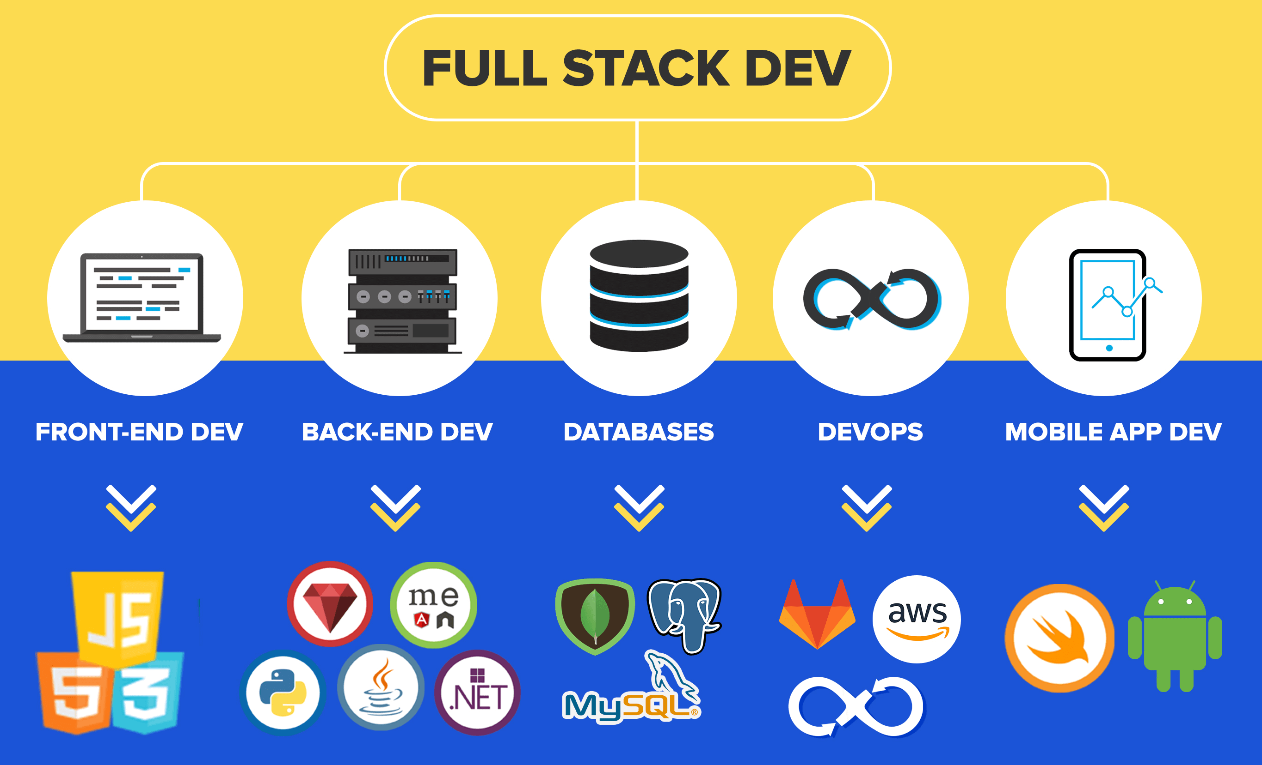

Slide 2











Slide 3
Course Objectives:
To familiarize with various technologies like HTML, CSS, JavaScript, XML, JSP and PHP to develop real-time web applications.
Course Outcomes:
identify various HTML tags and their purpose
develop dynamic web pages using HTML, CSS and Javascript
use XML to store and transport data
design web applications using JSP and PHP
connect to heterogeneous databases using JSP as well as PHP

Slide 4
Unit 1 – HTML & CSS
Unit 2 – JAVASCRIPT. JQuery & Bootstrap
Unit 3 – JSP and JDBC
Unit 4 –PHP Programming and MYSQL
Unit 5 –ReactJS

Slide 5
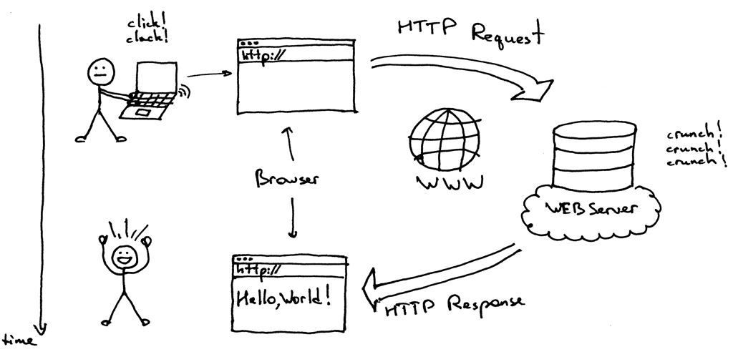

Slide 6

HTML:
Introduction
Basic HTML Tags
Lists
Tables
Forms
Frames
IFrames
Images
CSS:
CSS rules
Selectors
Types of CSS
CSS Properties

Slide 7


Slide 8
HTML
Hyper Text Markup Language
Hyper Text:
  Text with links to other text
  Images, Tables, Forms, other presentational elements
Markup Language:
  Contains a set of Markup “TAGS”
  Specifies how the document content should be displayed (PRESENTATION)

Slide 9
HTML:
  Developed by Tim Berners Lee in 1991
  Standards defined by W3C -> World Wide Web Consortium (W3schools.com)
  Latest version is HTML 5.0
  “Used for creating Static Web Pages”
  Defines the STRUCTURE & LAYOUT of a web page using tags & attributes
  Derived from SGML (Standard Generalized Markup Language)
  Can insert Images, Lists, Links, Tables, Forms, Audio & Video files etc

Slide 10
HTML TAGS:
Instructions to the Browser
They are Keywords placed in between Angle Brackets < >
Case Insensitive -> <b>==<B>
General form:
<tag>Tag content</tag>

Slide 11
Types of Tags:
  PAIRED TAGS
  UNPAIRED TAGS
  PAIRED TAGS:
  Come In Pairs → Start tag & End tag
  <i>This text is in Italics</i>
  UNPAIRED TAGS/ Empty Tags:
  No end tag and content
  <br>, <hr>

Slide 12
HTML DOCUMENTS/WEB PAGES
Plain text files → Text + HTML Tags
Written in Notepad, Wordpad or Text editors
Saved with extension .html or .htm
Opened in some WEB BROWSER
Browser does not display HTML tags but applies them to the text associated with those tags.
Example: <b> This text is in Bold </b>
Browser ignores whitespaces, tabs and new lines

Slide 13
HTML ELEMENTS:
Tag + attributes + content
<i> Text in italics </i>
HTML ATTRIBUTES:
Properties that provide additional information
Placed in start tag
attributename=value
<h1 align=center>This heading is aligned to center</h1>

Slide 14
STRUCTURE OF A HTML DOCUMENT
<html>
  <head>
  Head Section
  </head>
  <body>
  Body Section
  </body> (Visible page content)
  </html>

Slide 15

<html>
<head>
<body>
<title>
<h1> to <h6>
<p>
<b>
<i>
<u>
<sub>
<sup>
<strike>
<center>
<pre>
<br> & <hr>
<font>
<div>
<a>
<marquee>
HTML 5 :
<audio>
<video>

Slide 16
<html> - </html> : Root Element
<head> - </head> :
  <link> , <title> , <script>, <style> are the tags that can be added to the head section
<title> - </title> : defines the title of the document
<!-- --> : Comment tag
<body> - </body> : defines document body
Attribute | Value
alink | color
background | URL
bgcolor | color
link | color
text | color
vlink | color

Slide 17

Attribute | Value
Align | left right center justify

Slide 18
<b> - </b> : text will be Bold
<i> - </i> or <em> - </em> : text will be Italics
<u> - </u> : Underline
<strike> - </strike> : Strikes through text
<p> - </p> : Paragraph
<pre> - </pre> : Pre formatted text -> preserves spaces and line breaks
<big> - </big> : Bigger text
<small> - </small> : Smaller text
<sub> - </sub> : Subscript text (CH4)
<sup> - </sup> : Superscript text
<center> - </center>: alignes text to the center of the page
<tt> - </tt>: typed by a type writer

Slide 19
<br> - Inserts a Single line break
<hr> - Creates a Horizontal line. Used to separate content
<div> - </div> -
  defines a division or a section in an HTML document
  Used to group block of elements to format them with styles
Attribute | Value
Align | left right center justify

Slide 20
<font> - </font> :
<a> - </a>: Anchor tag
  Used to create hyper link to another document
Attribute | Value
color | rgb(x,x,x) #xxxxxx colorname
face | font_family
size | Number (1 - 7)
Attribute | Value
href | URL
target | _blank _self _parent _top framename

Slide 21
<marquee> - </marquee> : for scrolling text and images in the web page.
Attribute | Value
behavior | Scroll, Slide, Alternate
bgcolor | Colorname
direction | left, right, up, down
loop | number
scrolldelay | seconds
scrollamount | number

Slide 22

<audio> - </audio> - music or other audio streams.
<video>- </video> - movie clips or other video streams.
Attribute | Value
autoplay | autoplay
controls | Controls
loop | number
src | URL
Attribute | Value
height | pixels
width | pixels

Slide 23
Example audio
<h1>my music
<audio controls>
<source src="./mymusic.mp3" type="audio/mpeg">
</audio>
<br>

Slide 24
Example Video
<h1> my fav cartoon</h1>
<video controls autoplay width="300”height="200" >
<source src="./tomjerry.mp4“ type="video/mp4"/>
</video>

